Slide 1
Luminaria
2D Platformer Game Pitch
A game about transformation, growth, and finding your way home.
By Daria Boudreau
Group Collaborators: Sam Pham and Jude Fry

Slide 2
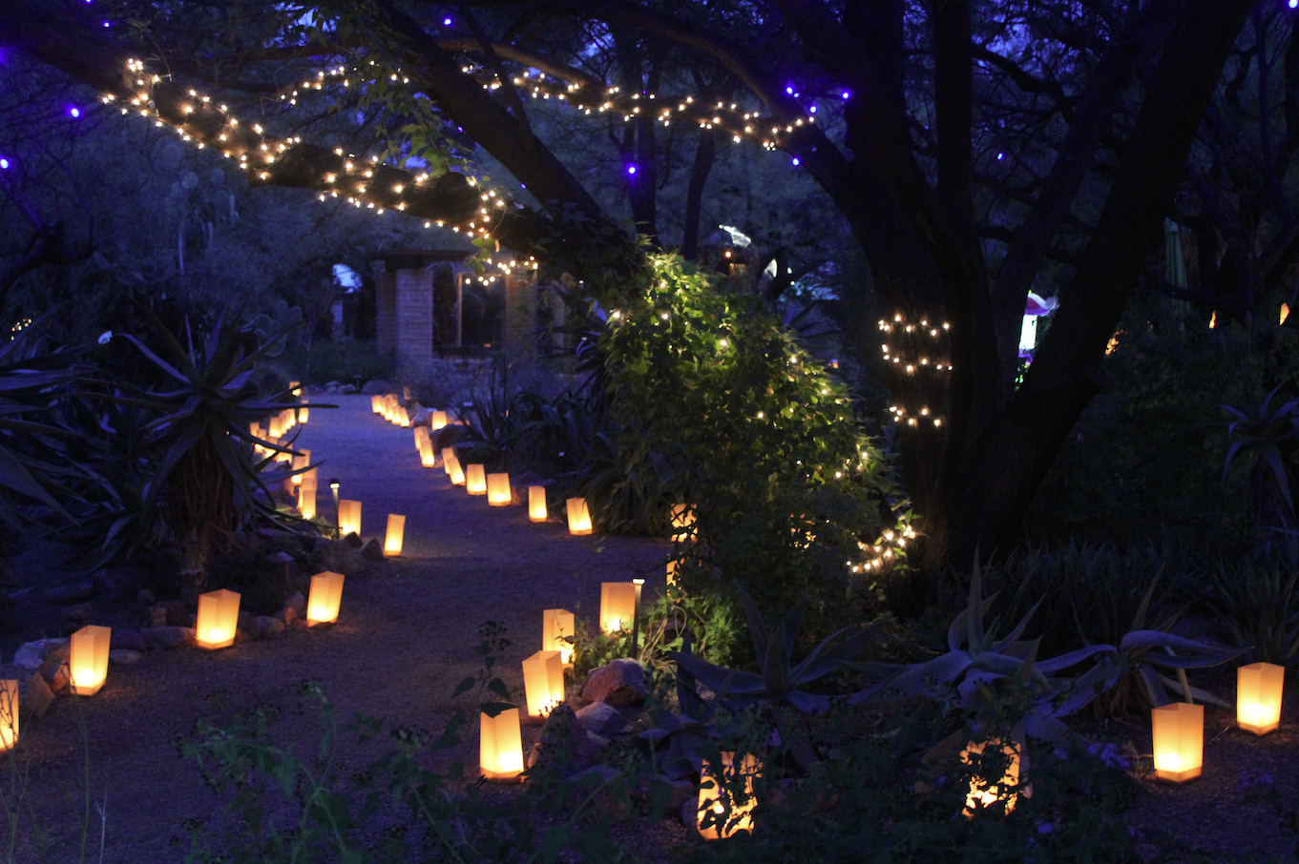
General Overview
Small-scale indie style game with simple mechanics, strong emphasis on story, and unique, stylized visuals
Gameplay: 2D side-scrolling platformer, character conversations and puzzles
Work with the constraints of the class and everyone’s skillsets
Mostly stylized 2D assets with minimal 3D as needed, very little complicated animation
The game’s title comes from the real word “Luminaria,” which refers to a traditional paper-lantern display that can be found in many different cultures.

Slide 3
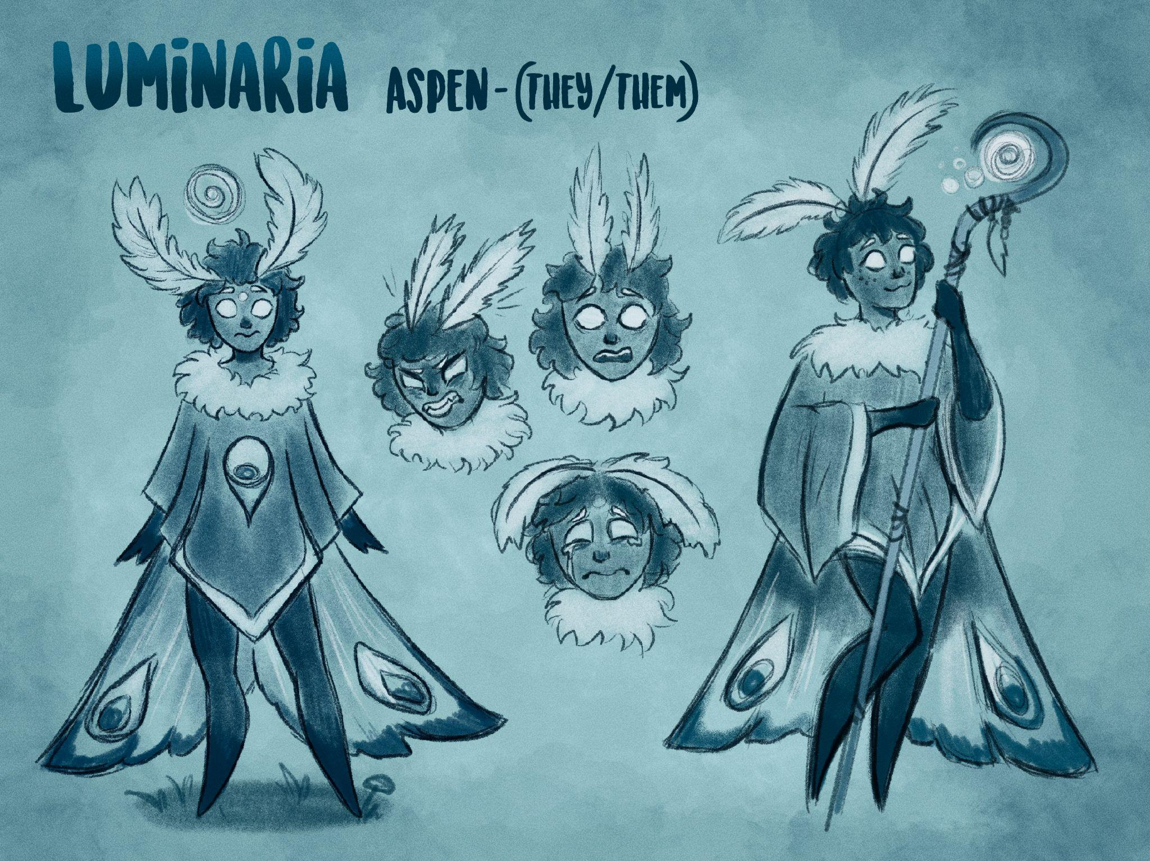
Story Pitch
A narrative-driven adventure that follows the story of Aspen, a young moth who has found themselves trapped in an unfamiliar world in the aftermath of a great tragedy.
Armed with only their trusty lantern lighter, Aspen must bring light to a dark world as they embark on a journey to find their way home.
Character conversations and scenes triggered by finding collectibles will help to unravel the story, but it will also be fairly ambiguous and up to interpretation

Slide 4
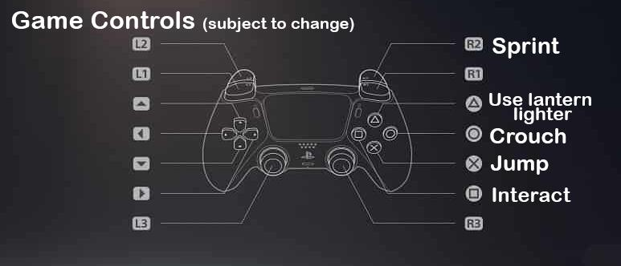
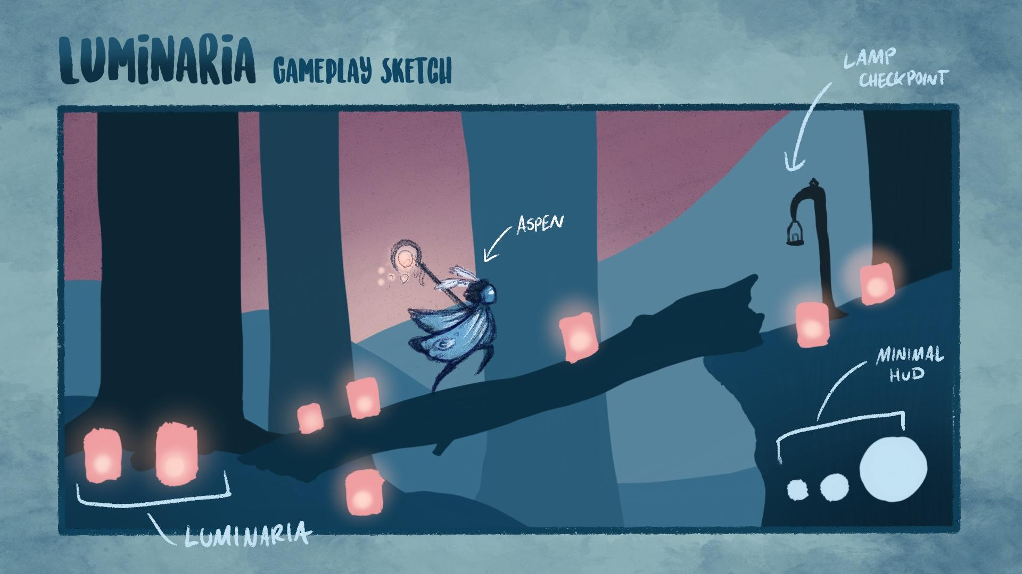
Gameplay
Traversing a 2D platform environment, puzzles, choosing dialogue options, collecting light to charge the lighter, lighting lanterns that serve as checkpoints
Single player, for PC or Console
Other mechanics: collectibles, basic character customization (Aspen can collect different sets of moth wings on their journey)

Slide 5
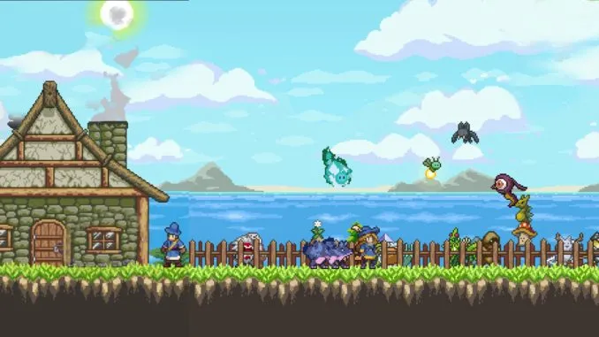
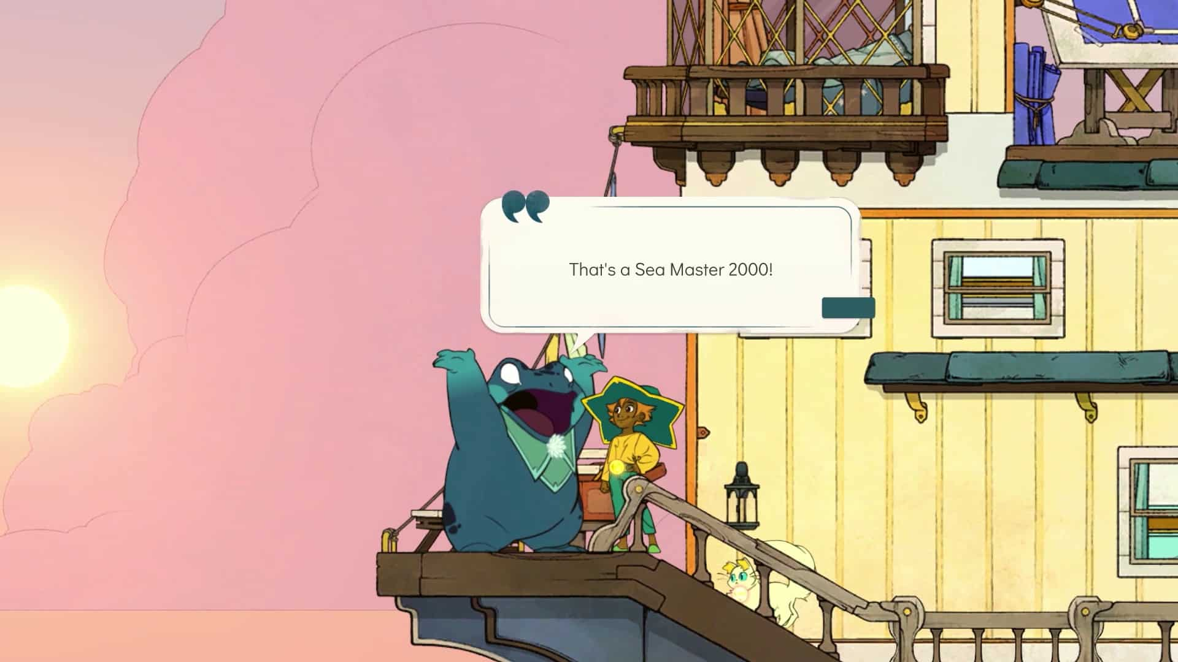
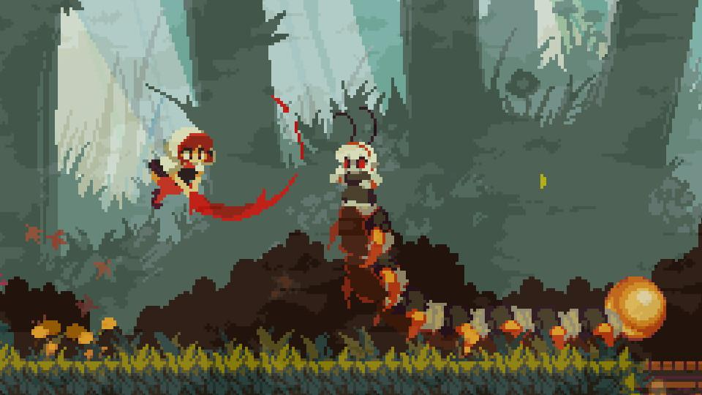
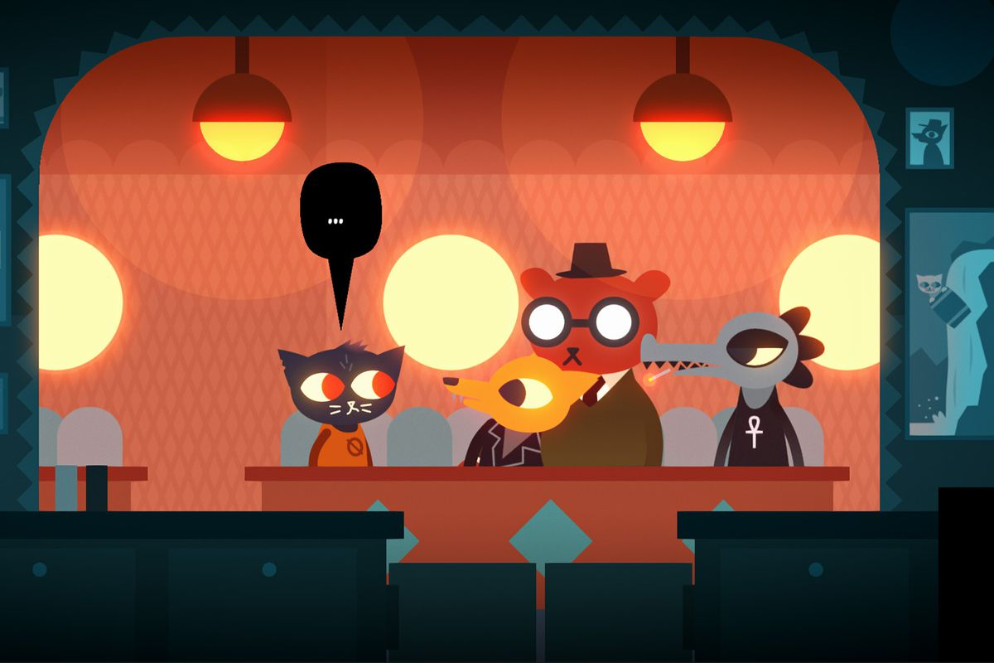
Visual Inspiration from Other Games

Slide 6
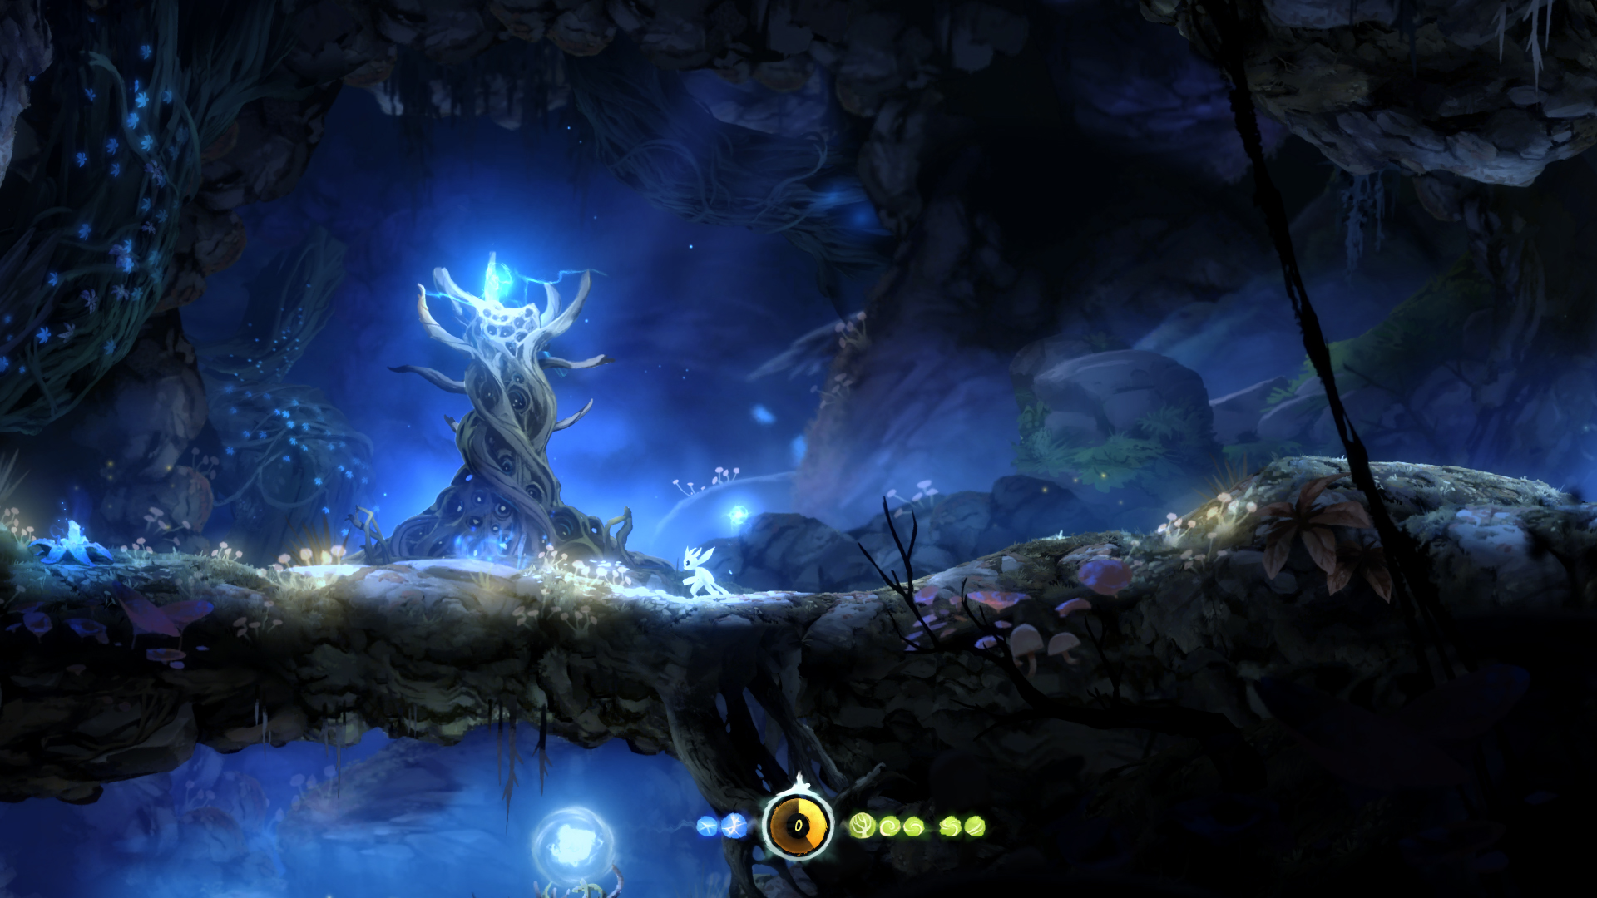
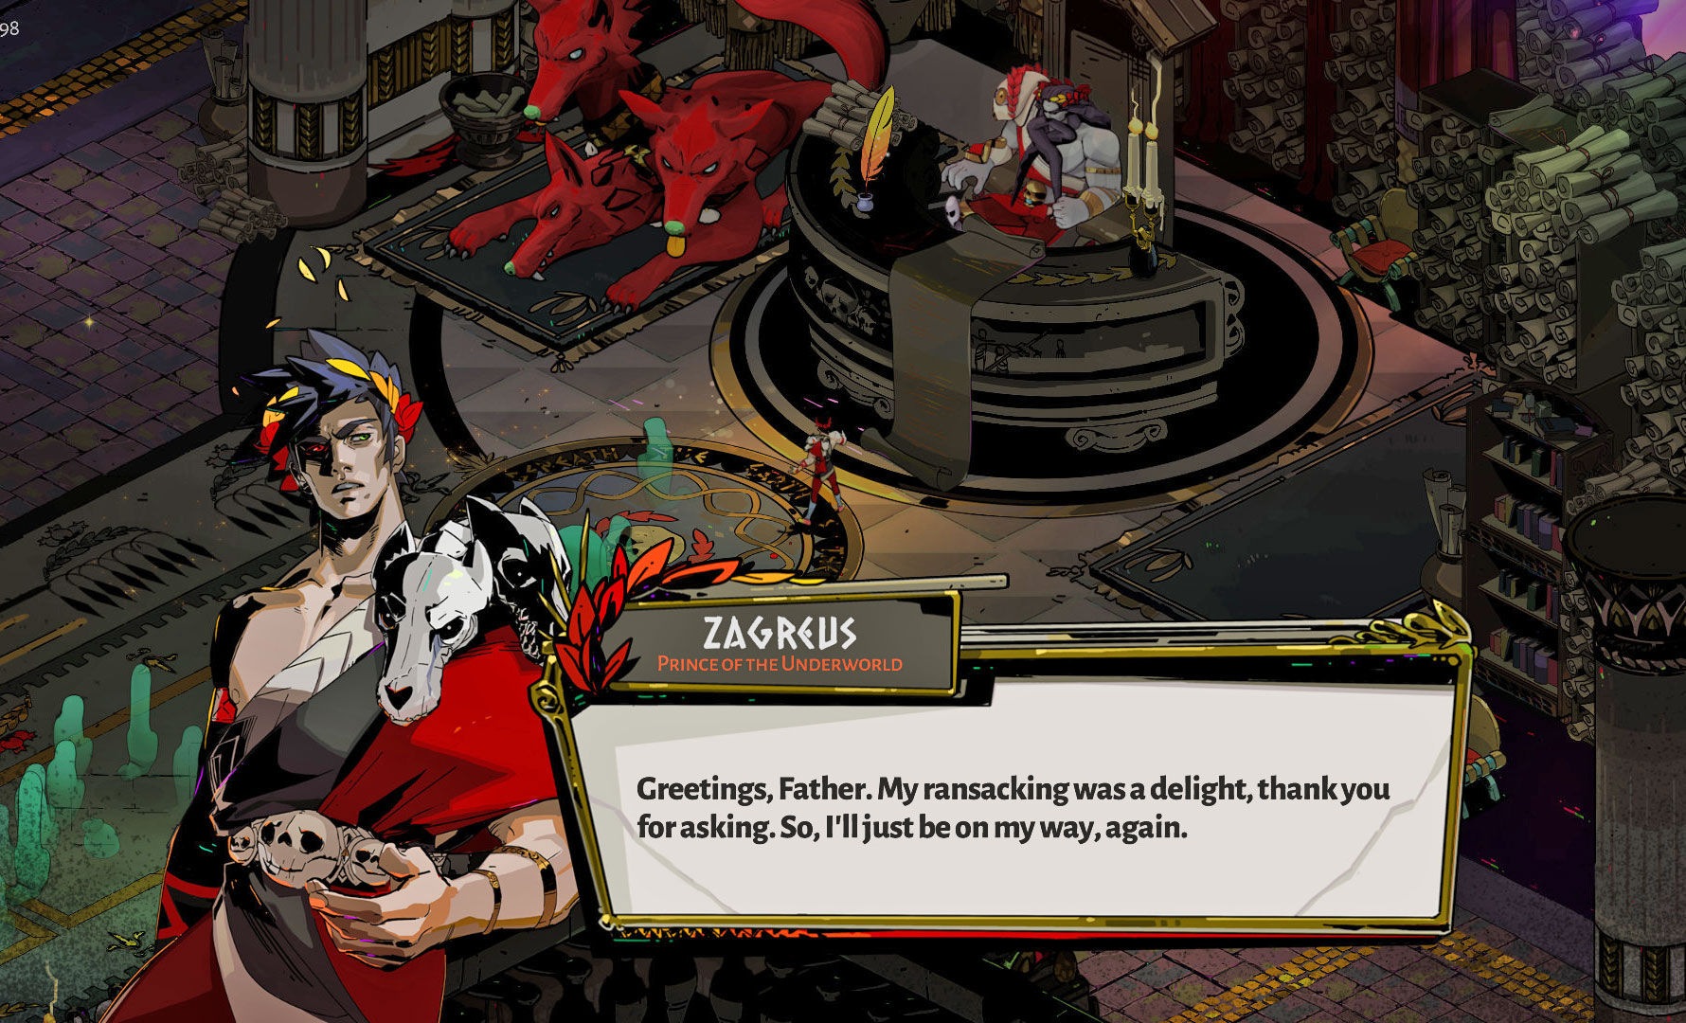
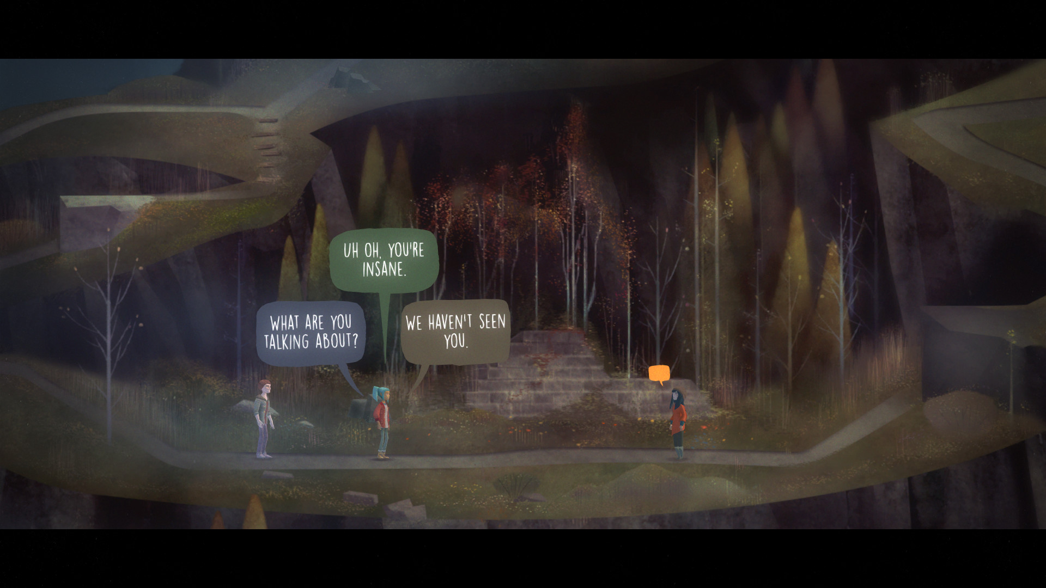
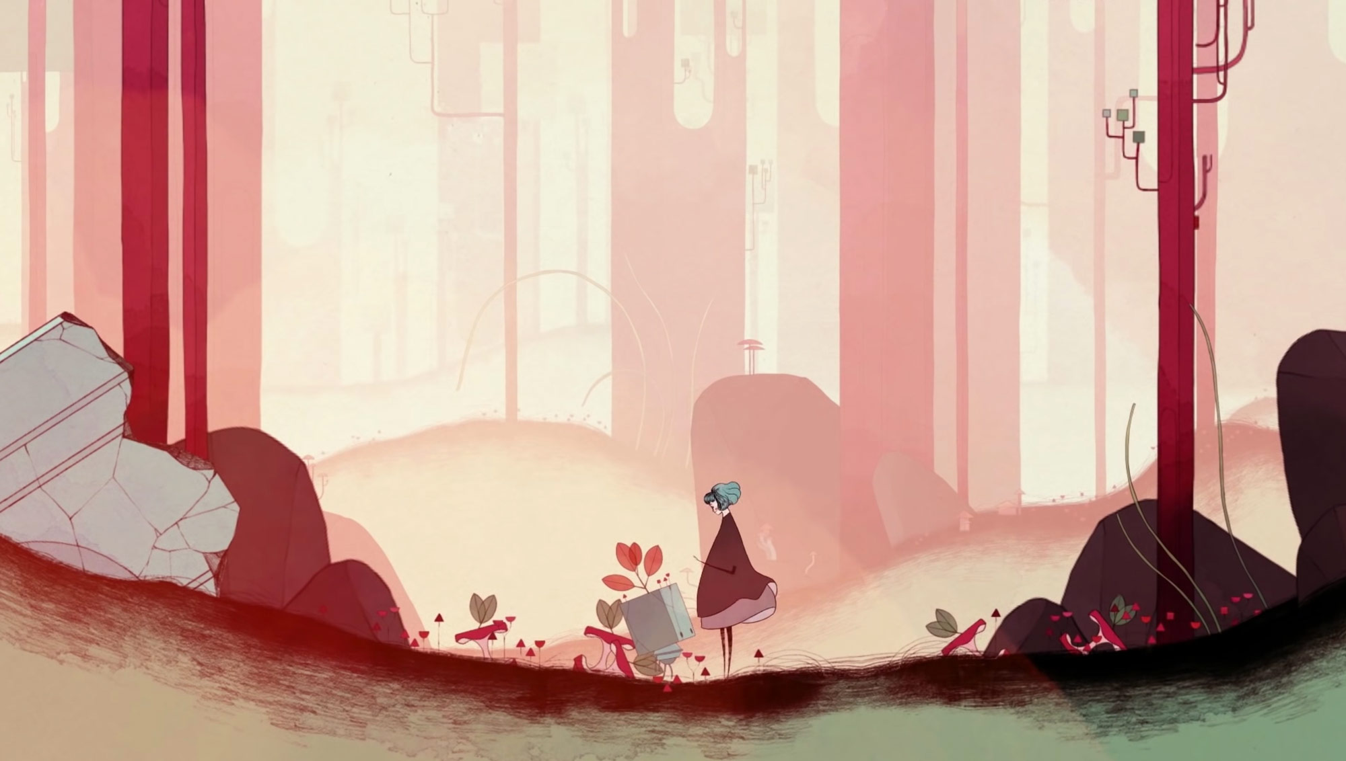
Visual Inspiration from Other Games

Slide 7
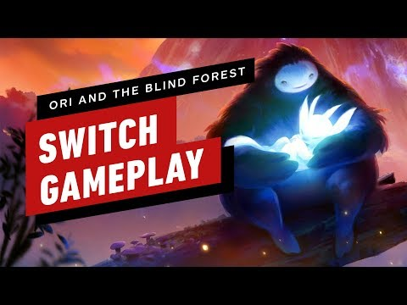
Gameplay Inspiration
https://www.youtube.com/watch?v=MZHOatlAZiY

Slide 8
Summary and Goals
My main goal is to create an engaging, portfolio-ready indie game experience.
Gameplay will be kept fairly simple so that the end result can be very polished, and the game doesn’t get bogged down with complicated systems.
The game should be appealing and easy to pick up for brand new players
By the end of the semester, I hope to at least have a “demo” version of the game with a few playable polished levels that give an understandable introduction to the story.
Most games produced by student teams have been 3D, so I’m looking forward to creating a fun, unique 2D gameplay experience.

